Slide 1
Continued...

Slide 2
Help
help(calculator)
________________________________________________________________________
Help on module calculator:
NAME
calculator
DESCRIPTION
Calculator Documentation
This class holds the calculator functions and memory variables.
-- More --

Slide 3
Lists & Dictionaries

Slide 4
Lists - Most general sequence
Positionally ordered collections of arbitrarily typed objects.
Mutable
Can be modified in place.
Provide a very flexible tool for representing arbitrary collections.

Slide 5
Lists and lists of lists
Initialize with []s and “,” separator.
book1 = ["Learning Python", "Mark Lutz", 2013]
book2 = ["As I Lay Dying", "William Faulkner", 1930]
books = [book1, book2]

Slide 6
Can access parts by using []s.
REMEMBER – INDEXES START AT 0!!!
print(books[0])
print(books[1][2])
______________________________________________________________________
['Learning Python', 'Mark Lutz', 2013]
1930

Slide 7
Can do lots of fun stuff.
Get columns
authors = [row[1] for row in books]
print(authors)
____________________________________________________________________
['Mark Lutz', 'William Faulkner']

Slide 8
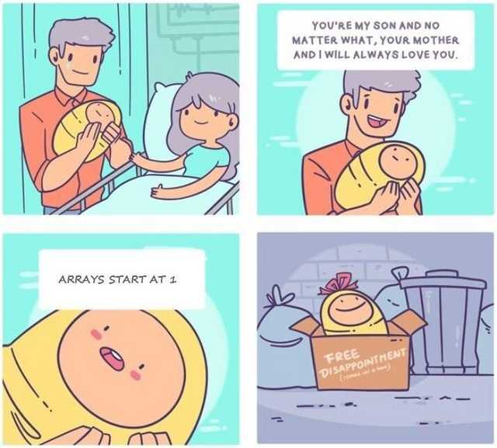

Slide 9
Dictionaries
Mappings
book1 = {"title": "Learning Python", "author": "Mark Lutz", "PubDate": 2013 }
book2 = {"title": "As I Lay Dying", "author": "William Faulkner", "PubDate": 1930 }
books = [book1, book2]
for book in books:
print(book["title"])
______________________________________________________________________
Learning Python
As I Lay Dying

Slide 10
Dictionaries
tempTitle = input("Enter Title: ")
tempAuthor = input("Enter author: ")
tempPubDate = int(input("Enter Publication Year: "))
book3 = dict(title = tempTitle, author = tempAuthor, PubDate = tempPubDate )

Slide 11
Dictionaries
But what will happen if you don’t have an attribute?
book1 = {"title": "Learning Python", "author": "Mark Lutz", "PubDate": 2013 }
book2 = ["author": "William Faulkner", "PubDate": 1930 }
books = [book1, book2]
for book in books:
print(book["title"])
______________________________________________________________________
Learning PythonTraceback (most recent call last):
File “Example.py", line 7, in <module>
print(book["title"])
KeyError: 'title'

Slide 12
Enum
from enum import Enum
class Color(Enum):
RED = 0
GREEN = 1
BLUE = 2

Slide 13
File I/O

Slide 14
File I/O
Write to a file
myfile = open('myfile.txt', 'w')
myfile.write('Hello text file\n')
myfile.write('Goodbye text file\n')
myfile.close()

Slide 15
File I/O
Read a file
myfile = open('myfile.txt')
print(myfile.readline())
print(myfile.readline())
print(myfile.readline())

Slide 16
File I/O
Storing Python Objects in JSON Format
import json
json.dump(books, fp=open('myFile.txt','w'), indent=4)
fp=open(…) is required, don’t rename it. Also, JSON doesn’t “play nicely” with Enums. There is a way to do it, but it’s not standard; look it up if you’re interested.

Slide 17
File I/O
Reading Python Objects from JSON Format
import json
newBook = json.load(open('myFile.txt'))

Slide 18
See Books.py for an example

